Slide 1



SQL and MySQL

Slide 2
Course Summary
1
Databases, SQL, MySQL
2
Installations
3
SQL database concepts
4
Creating tables
5
Basic queries
6
Advanced queries
7
Nested queries
8
Joins and Unions
9
Database design

Slide 3
Databases, SQL, MySQL

Slide 4
Quick links to get help
Google
W3 school tutorial
MySQL official documentation
MySQL Workbench documentation
Tutorialspoint tutorial
Geeks for Geeks

Slide 5

Databases
Database = file stored on disk organized for storing data
A relational database organizes data into data tables in which data types may be related to each other.
Examples of DataBase (DB): Spreadsheet, Linkedin’s user base, Guests list to attend an event, etc.
ID | First Name | Last Name | Age | Nationality
1 | Jack | Dubois | 28 | French
2 | Jane | Poppins | 34 | American
3 | Claire | Kennies | 22 | Brittish
4 | Lea | Sharock | 33 | Israeli

Slide 6
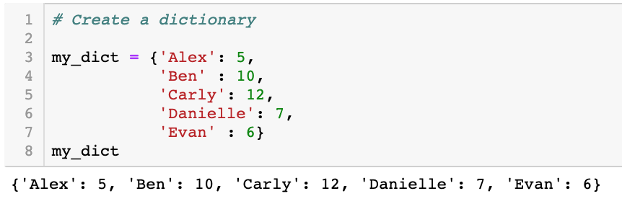
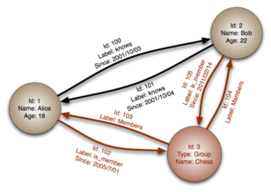
Two types of Databases
Relational Databases (SQL)
Non-Relational Databases (noSQL)
Organize data into one or more tables:
Each table has columns and rows
A unique key identifies each row
Organize data is anything but a traditional table:
Key-value stores
Documents (JSON, XML, etc)
Graphs
Flexible tables
ID | First Name | Last Name | Age | Nationality
1 | Jack | Dubois | 28 | French
2 | Jane | Poppins | 34 | American
3 | Claire | Kennies | 22 | Brittish
4 | Lea | Sharock | 33 | Israeli

Slide 7
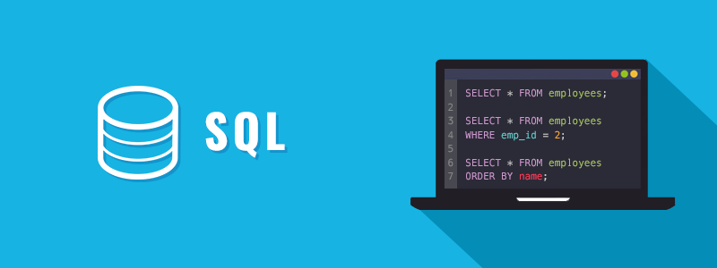
SQL: Structured Query Language
SQL (Structured Query Language) = standardized language used for creating, modify and extract data from a relational database.
SQL is a language to interact with RDBMS
Used to perform C.R.U.D operations (Create, Read, Update and Delete)
Used to define tables and structures
ACID (Atomicity, Consistency, Isolation, Durability) = set of properties of database transactions intended to guarantee data validity despite errors, power failures and so on.
Transaction = a sequence of database operations that satisfies the ACID properties.
Every SQL statement ends with ; meaning the end of the statement.

Slide 8
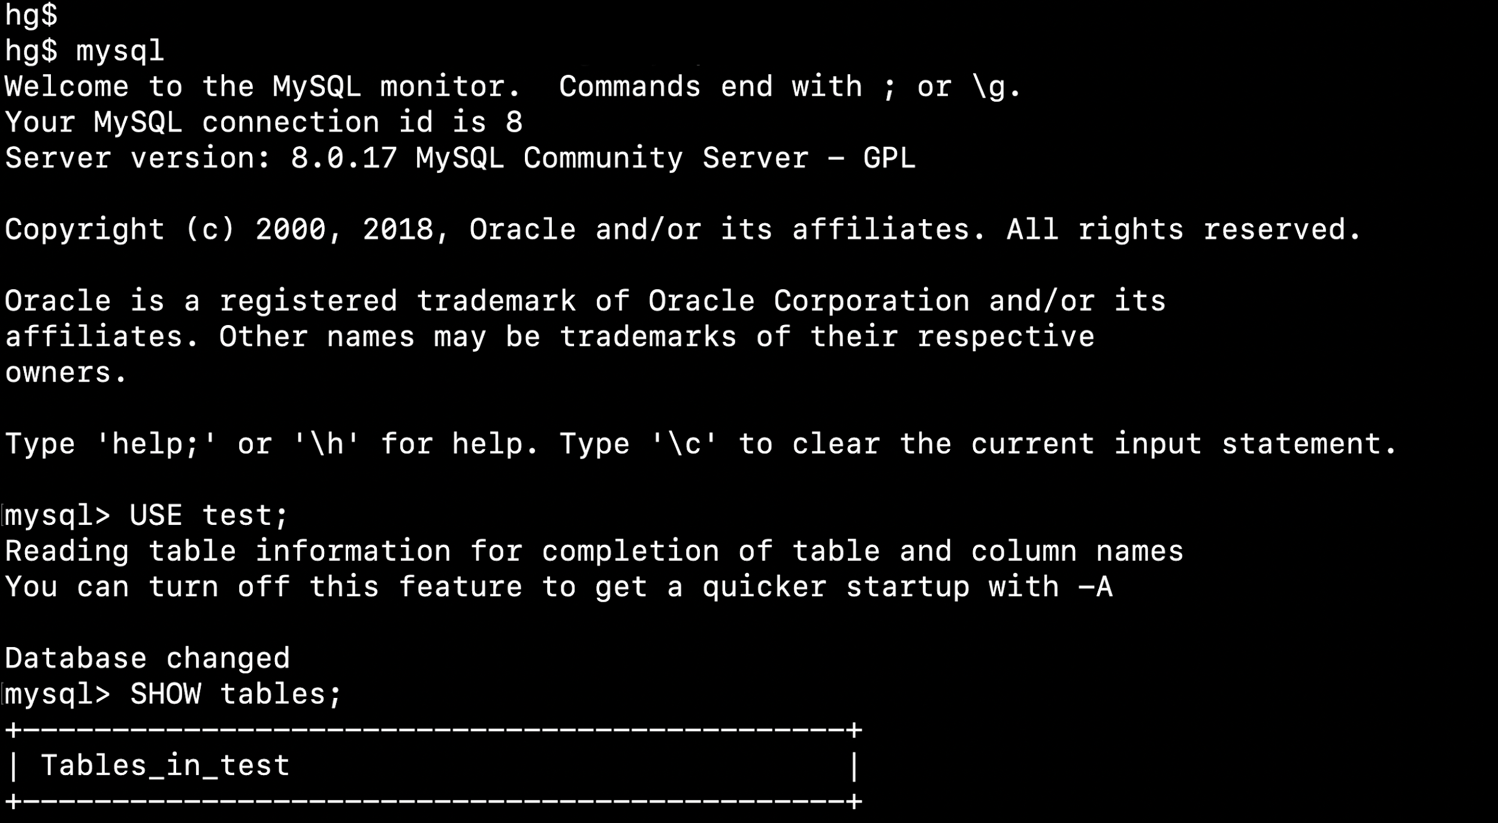
MySQL (My + SQL)
DBMS = software program that helps users create and maintain a database.
MySQL = open-source relational database management system (RDBMS)
SQL is a declarative language useful to handle structured data
One of the greatest advantage is that you can with a single command access multiple records within a database.

Slide 9
Applications of SQL
Access data in the RDBMS.
Describe the data.
Define the data in a DB and manipulate it.
Embed within other languages using SQL modules, libraries.
Create and drop databases and tables.
Allow to set permissions on tables, procedures and views.

Slide 10
Installations

Slide 11
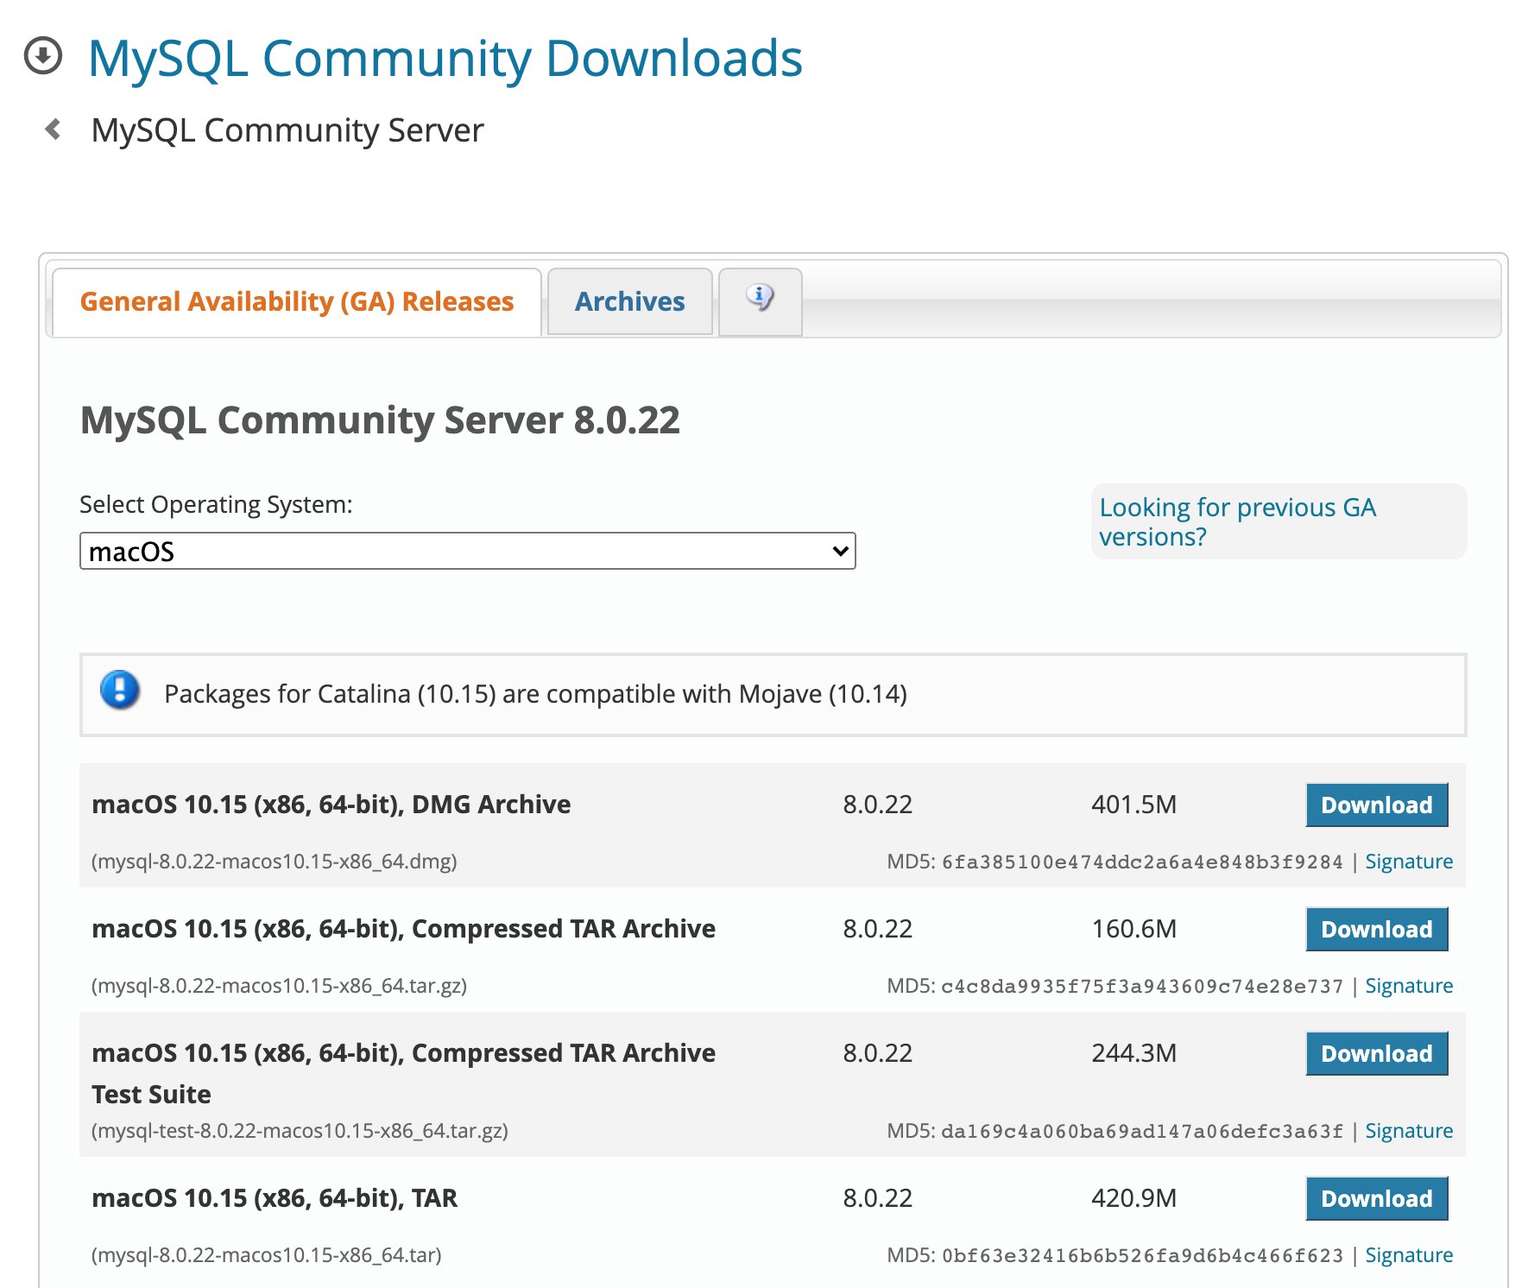
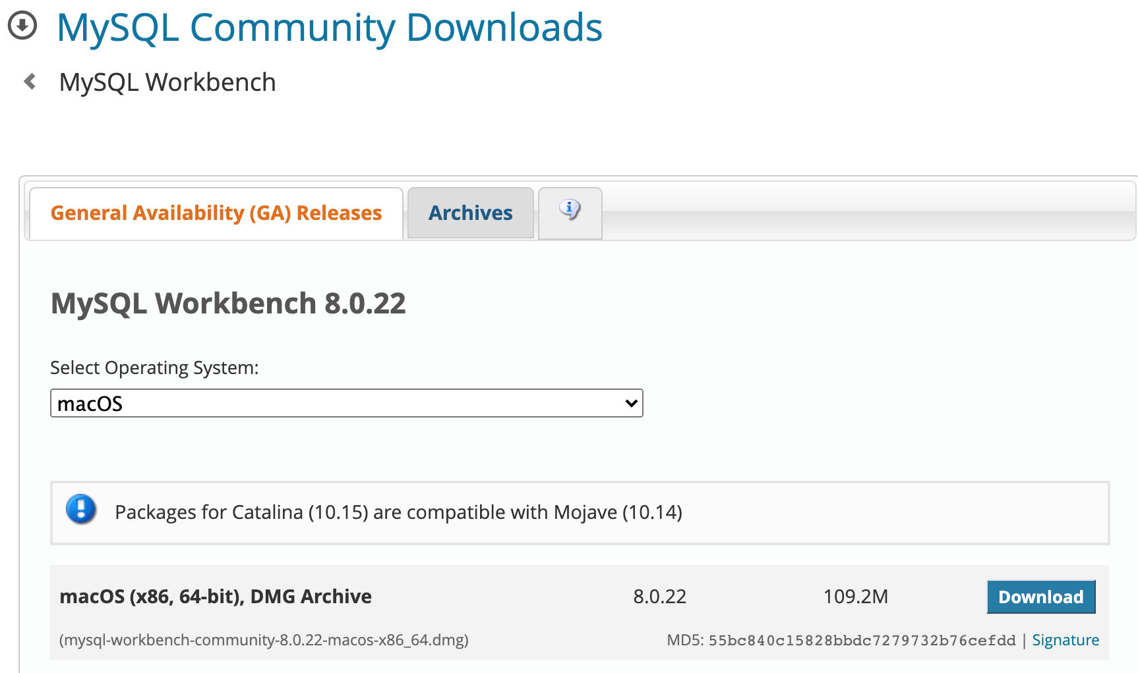
Installation (1/2)
Go to the official website MySQL Community edition > Downloads

Slide 12
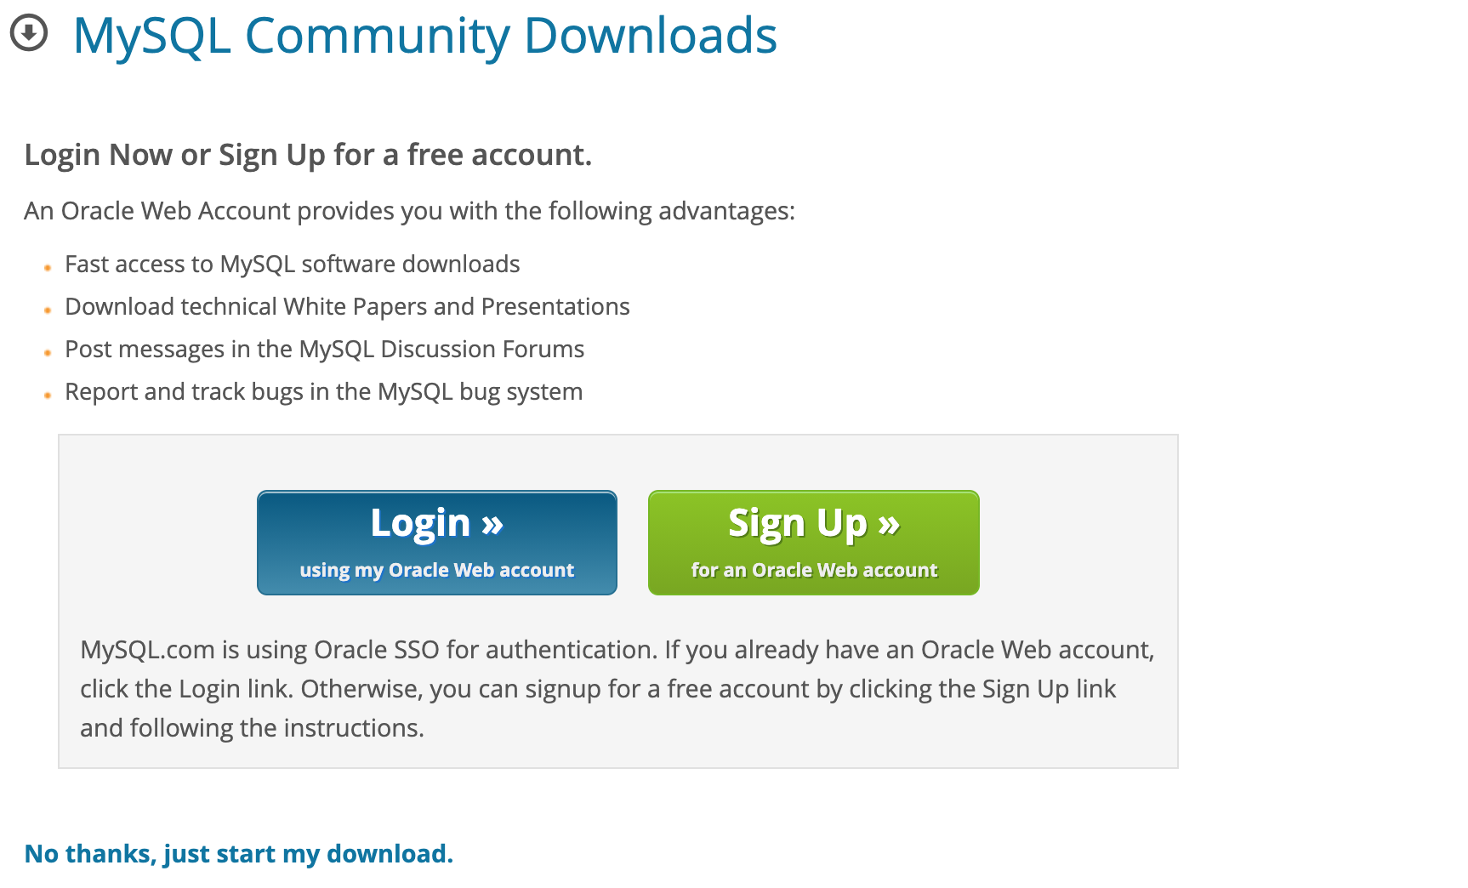
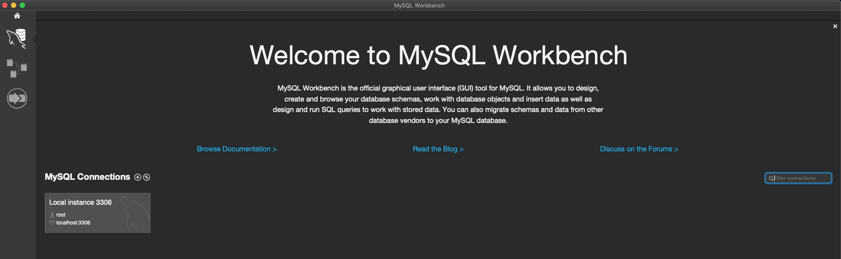
Installation (2/2)

Slide 13
SQL database concepts

Slide 14

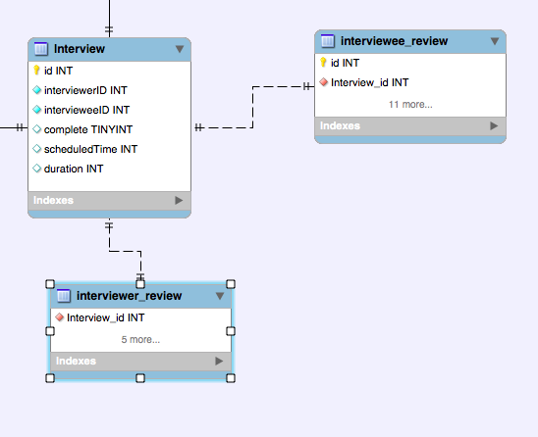

Database schema
Database schema = its structure described in formal language supported by the DBMS
Database
Table 1
Table 2
Table 3

Slide 15

Database queries
Query = A set of instructions given to the RDBMS (written in SQL) that tell the RDBMS what information you want it to retrieve for you:
There can be hundreds or thousands of GB in a DB
Often hidden in a complex schema
Goal = only get the data you need
As the database’s structure become more and more complex, it becomes more difficult to get the specific pieces of information we want.
Example: a google search is a query

Slide 16
Tables & Keys
Tables:
Columns = attributes
Rows = entries
Keys
We always have a Primary Key (PK) in a table. It will be unique for each row and uniquely identifies a given row.
We may have a Foreign Key (FK) in the table. It will link this table to another table. It is the PK of another table. A FK allows us to define relationships between tables.
Students
Countries
ID (PK) | First Name | Last Name | Age | Nationality (FK)
1 | Jack | Dubois | 28 | French
2 | Jane | Poppins | 34 | American
3 | Claire | Kennies | 22 | Brittish
4 | Lea | Sharock | 33 | Israeli
Nationality (PK) | Country name | Monument
French | France | Eiffel tower
American | US | Statue of Liberty
Brittish | UK | London bridge
Israeli | Israel | Dizengoff square

Slide 17
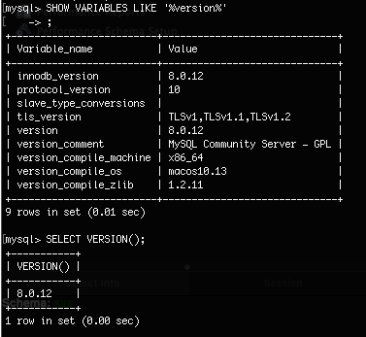
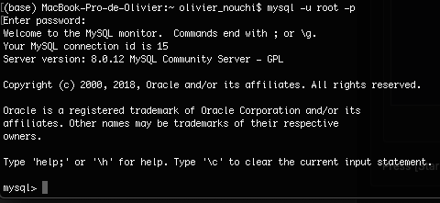
Using the command prompt to access mysql
The computer does not know what ‘mysql’ stands for in the prompt. We need to create a shortcut:
MacOS
echo ‘export PATH=/usr/local/mysql/bin:$PATH’ >> ~/.bash_profile
. ~/.bash_profile
mysql -u root -p
Windows: open MySQL Command Line Client, enter your password
Check your MySQL version (inside MySQL):
SHOW VARIABLES LIKE ‘%version%’
SELECT VERSION();
STATUS;
Create a database: CREATE DATABASE database_name

Slide 18
Creating tables

Slide 19
Data types
INT: whole numbers
DECIMAL(M, N): decimal numbers - exact value:
Example: DECIMAL(10,4)
VARCHAR(100): string of text of length 100
BLOB: Binary Large OBject, stores large data (images, files, etc.)
DATE: ‘YYYY-MM-DD’
TIMESTAMP: ‘YYYY-MM-DD HH:MM:SS’ - used for recording
More data types here (official documentation)
W3 school tutorial

Slide 20
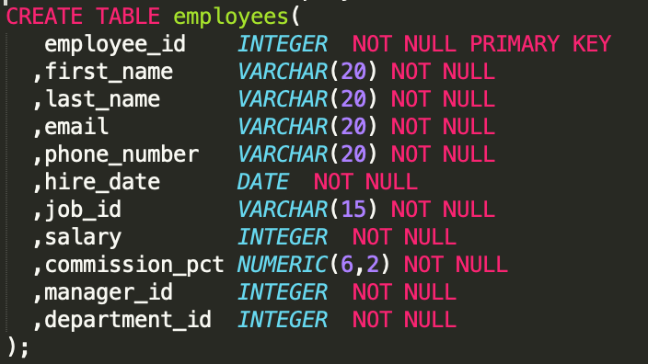
Create a table

Slide 21
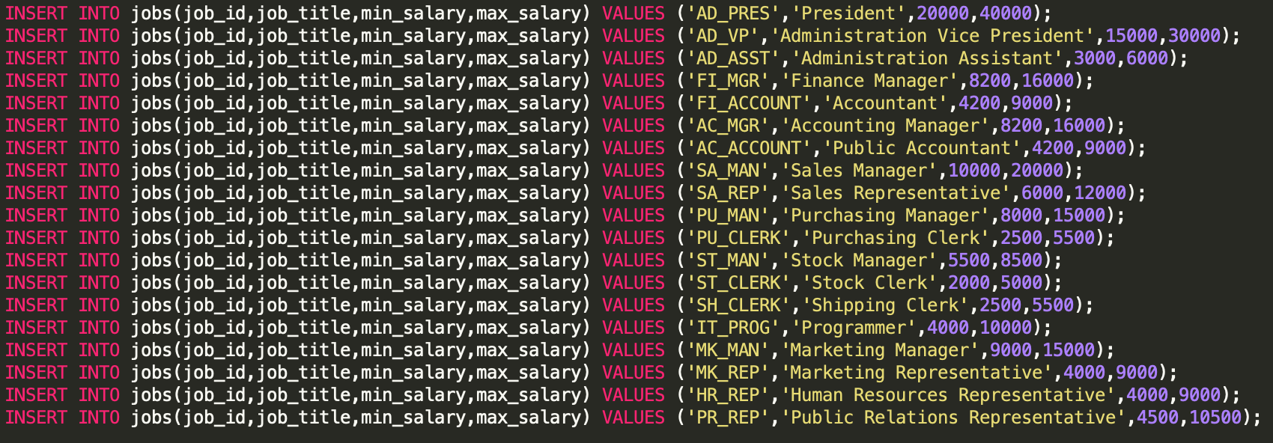
Insert data

Slide 22
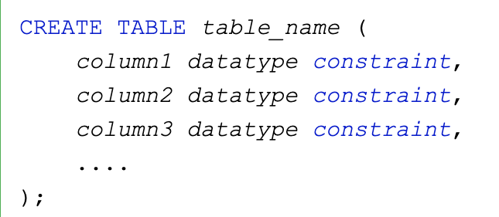
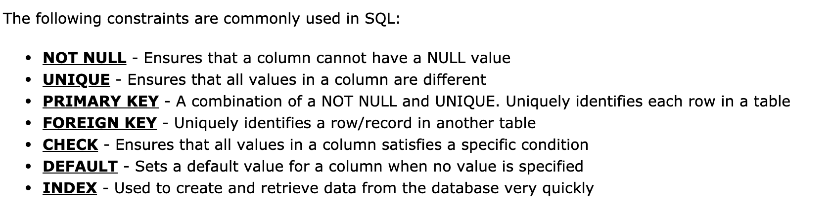
Constraints
Constraints = Specify rules for data in a table
Constraints can be specified either:
Before the table is created with the CREATE TABLE statement
After the table was created with the ALTER TABLE statement

Slide 23
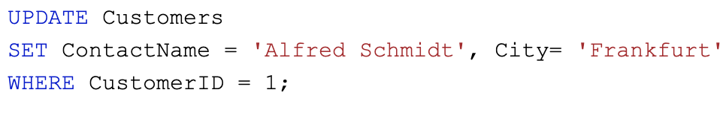
Update & Delete
UPDATE statement → modifies the existing records in the table
DELETE statement → delete existing records in the table

Slide 24
Basic queries

Slide 25
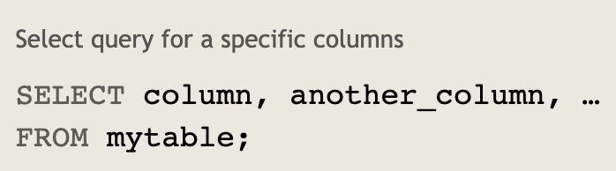

SELECT STATEMENT (1/2)
SELECT → select specific columns data from a database
The data returned is stored in a result table, called the result-set

Slide 26
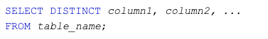
SELECT DISTINCT STATEMENT (1/2)
SELECT DISTINCT → returns only distinct (different) values
Inside a table, a column often contains many duplicate values and sometimes you only want to list the distinct values.

Slide 27
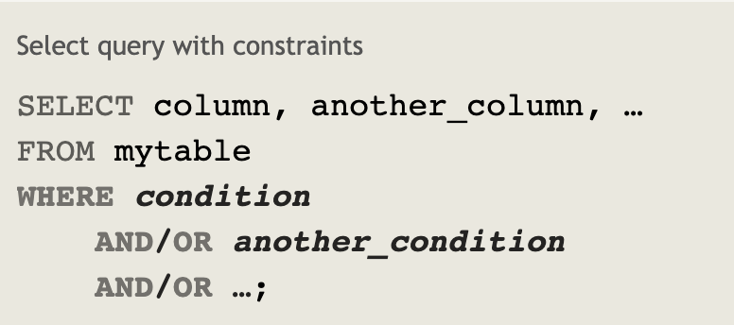
WHERE CLAUSE (1/2)
WHERE → used to filter records
Used to extract only records that meet specified conditions.

Slide 28
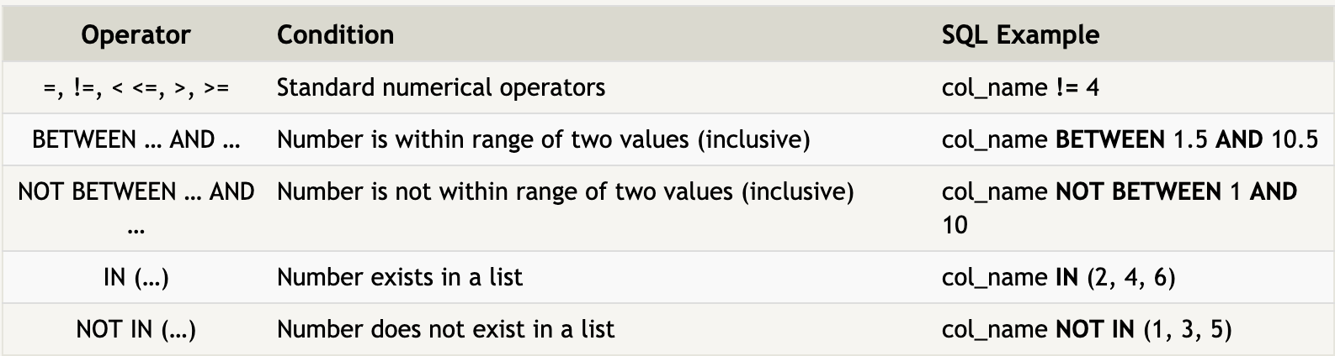
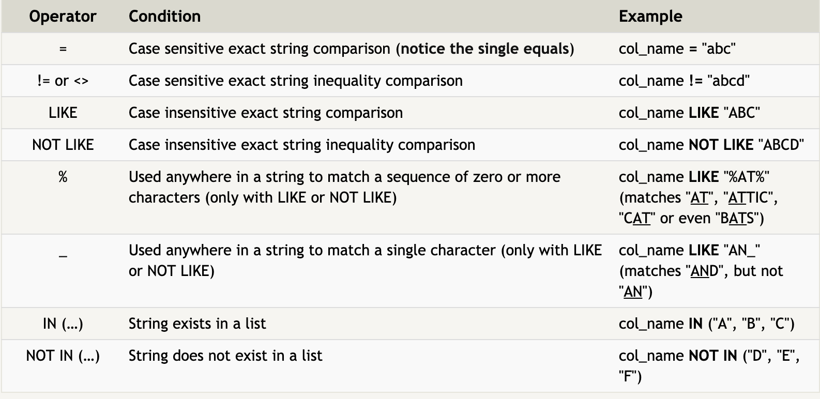
COMBINING CONDITIONS (2/2)
The WHERE clause can be combined with logical operators (AND, OR, NOT)

Slide 29
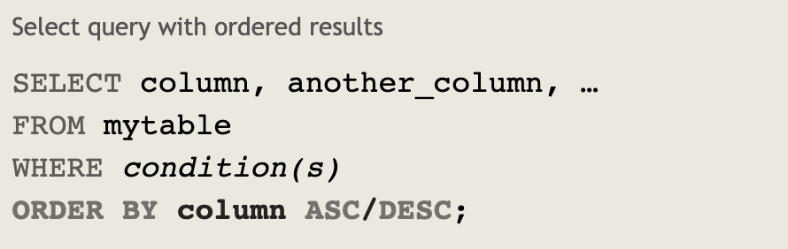
ORDERING RESULTS
ORDER BY keyword is used to sort the result-set in ascending order or descending order
Ascending order by default

Slide 30
ORDERING RESULTS
ORDER BY keyword is used to sort the result-set in ascending order or descending order
Ascending order by default

Slide 31
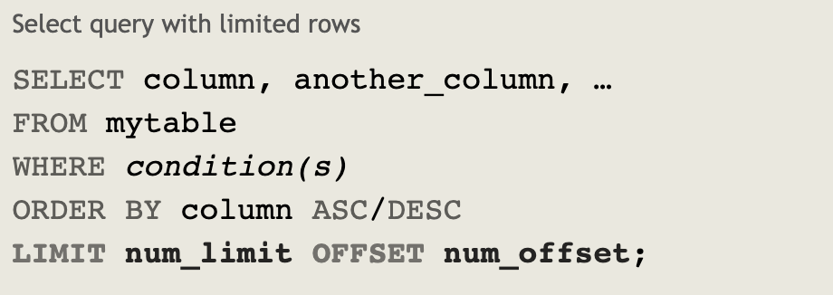
LIMITING RESULTS
LIMIT will reduce the number of rows to return
OFFSET specifies where to begin counting the number rows from (offsets starts from 0)

Slide 32
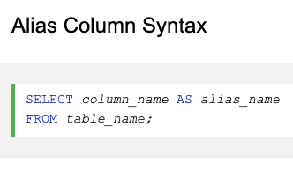
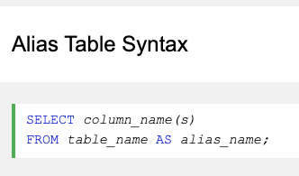
ALIASES
AS is the keyword to give a table, or a column in a table a temporary name.
Aliases are often used to make column names more readable.
An alias only exists for the duration of the query

Slide 33
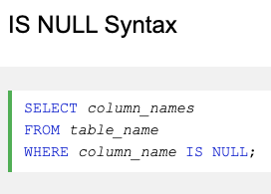
SQL NULL VALUES
NULL value is a field with no value
If a field in a table is optional, it is possible to insert a new record or update a record without adding a value to this field.
Then, the field will be saved with a NULL value.

Slide 34
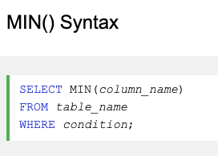
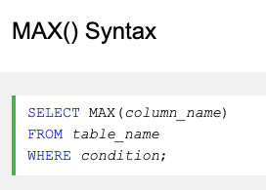
MIN, MAX
MIN() returns the smallest value of the selected column
MAX() returns the largest value of the selected column

Slide 35
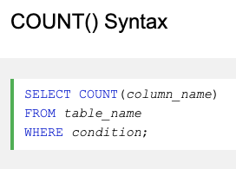
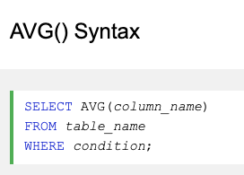
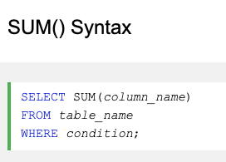
COUNT, AVERAGE, SUM
COUNT() returns the number of rows that matches a specified criteria
AVG() returns the average value of a numeric column
SUM() returns the total sum of a numeric column

Slide 36
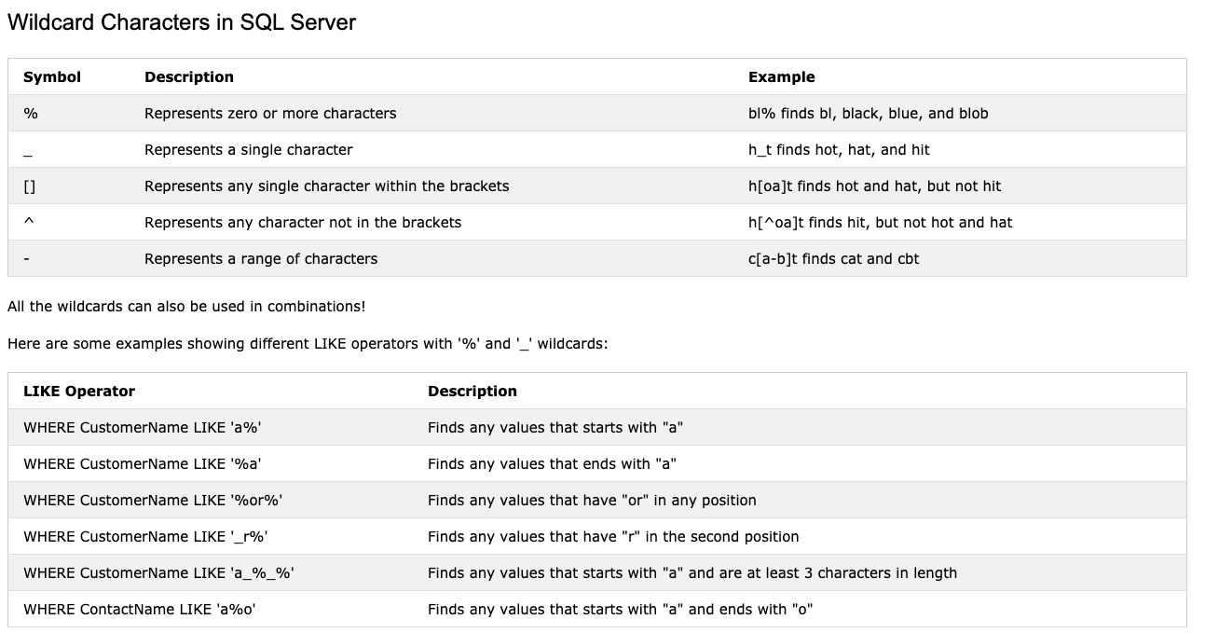
Wildcards
Wildcard characters are used to substitute one or more characters in a string.
They are used with the SQL LIKE operator.

Slide 37
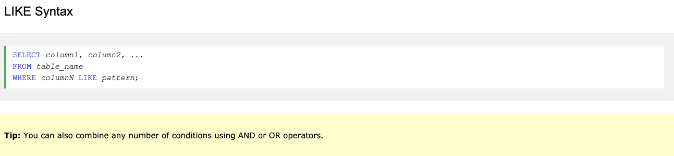
LIKE
LIKE operator is used in a WHERE clause to search for a specified pattern in a column
There are 2 wildcards often used in conjunction with the LIKE operator:
% - the percent sign represents 0, 1 or multiple characters
_ - the underscore represents a single character

Slide 38
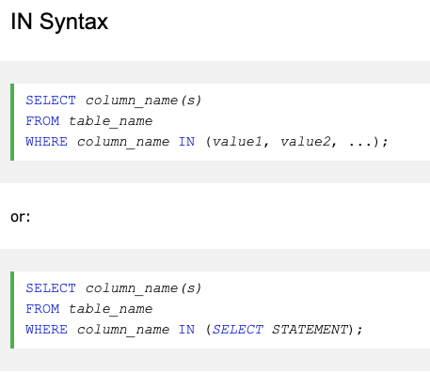
IN
IN operator allows you to specify multiple values in a WHERE clause
The IN operator is a shorthand for multiple OR conditions

Slide 39
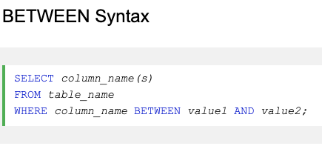
BETWEEN
BETWEEN operator selects values within a given range.
The values can be numbers, text or dates.
The BETWEEN operator is inclusive: begin and end values are included.

Slide 40
Advanced queries

Slide 41
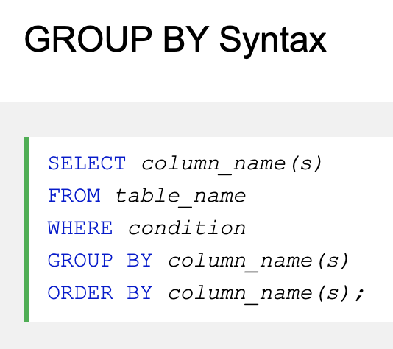
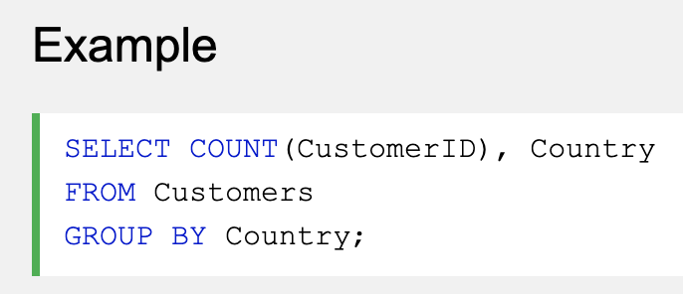
GROUP BY
GROUP BY statement groups rows that have the same values into summary rows (like find the number of customers in each country → group by country and aggregate the rows).
The GROUP BY statement is often used with aggregate functions (COUNT, MAX, MIN, SUM, AVG) to group the result-set by one or more columns.
How many customers are there per country?

Slide 42
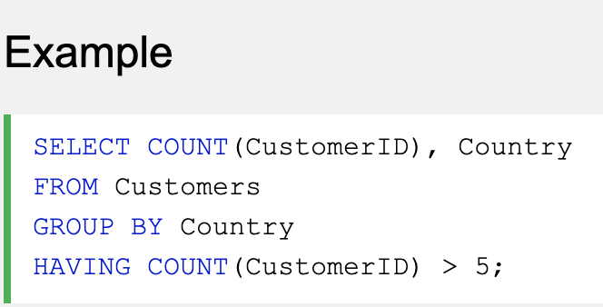
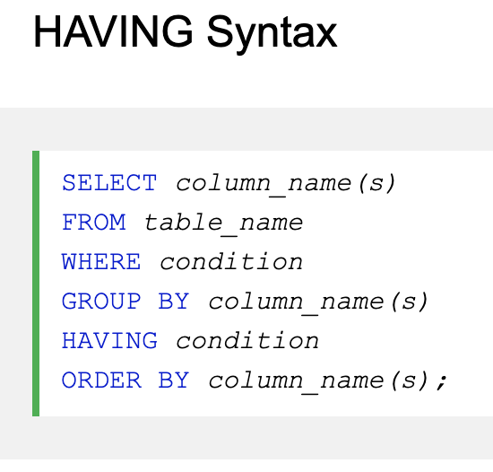
HAVING
HAVING clause was added to SQL because the WHERE keyword could not be used with aggregate functions.
Same use as WHERE but to filter after the data was aggregated.
How many customers are there per country? But only include countries with more than 5 customers

Slide 43
Practice time!

Slide 44


SQL interactive exercises

Slide 45

SQL w3 school exercises

Slide 46

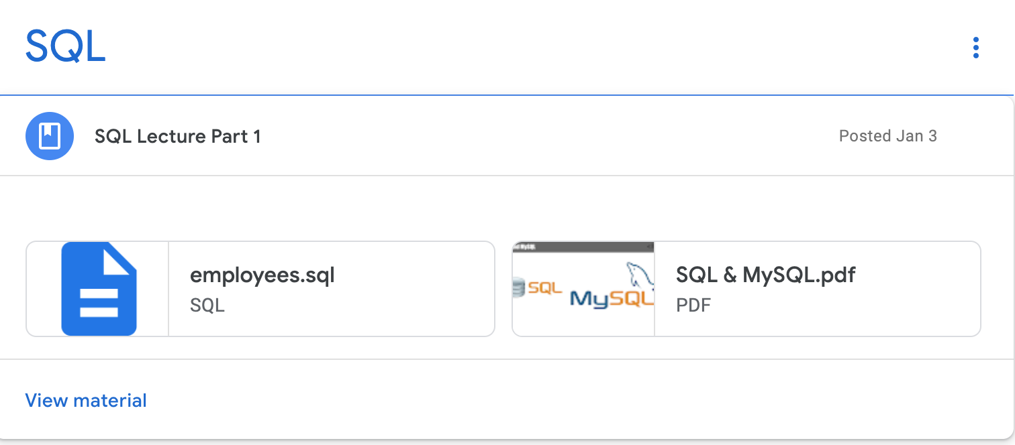
Workbench Practice - Employee table

Slide 47
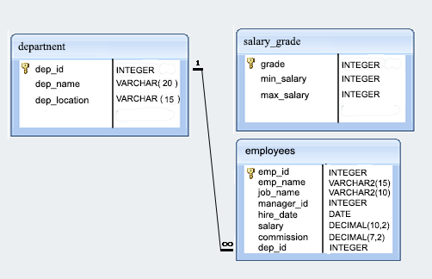
Structure of employee DB

Slide 48
Questions part 1
Q1: Display all the information about the employees.
Q2: Find the salaries of all employees.
Q3: Display the unique designations (=jobs) for the employees.
Q4: Produce an output of employees name and job name as a format of “Employee & Job” (hint: use a function).
Q5: List all the employees with a hired date in the format like February 22, 1991.
Q6: Count how many employees are in the company.
Q7: List the emp_id, salary, commission of all the employees.
Q8: List the employees who do not belong to department 2001.
Q9: List all the employees who joined before 1991.
Q10: Display the average salaries of all the employees who work as analysts.
Q11: Display the details of the employee named BLAZE.
Q12: Display the details of the employees whose commission is more than their salary.
Q13: List the employees whose salary is more than 3,000 after giving it a 25% raise.

Slide 49
Questions part 2
Q14: List the names of the employees who have 6 characters in their names.
Q15: List all the employees who joined in January.
Q16: List all the employees who work as salesman.
Q17: List all the employees whose salaries are less than 3,500.
Q18: List the employee name and job name of the employees who are not working under a manager.
Q19: List the employee id, name and salary of all the employees working for the manager 68319.
Q20: List all the employees whose salary contain only 3 digits.
Q21: List all the employees in the descending order of their salaries.
Q21: Find all the employee who has the highest salary.
Q22: Find all the employee who has the lowest salary.
Q23: List all the employees whose names contain the characters ‘AR’ together.

Slide 50
Unions and Joins

Slide 51
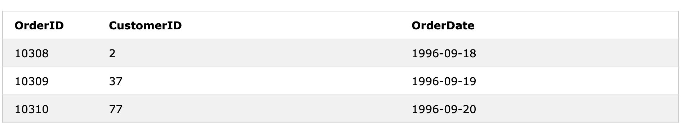
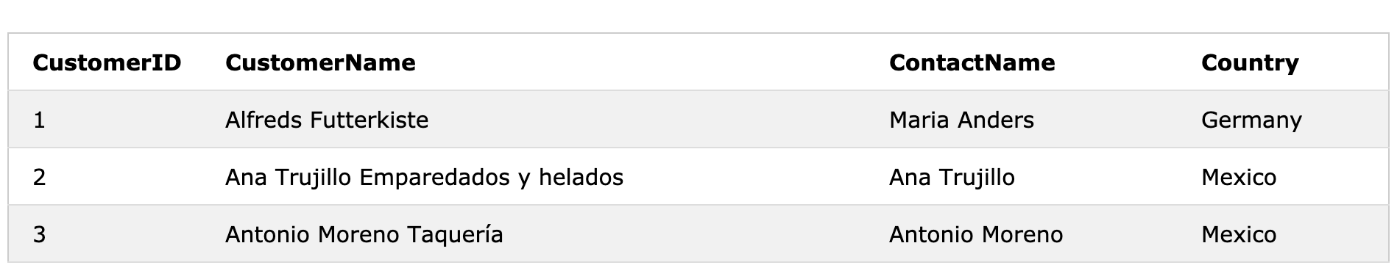
JOINS
JOIN clause is used to combine rows from two or more tables, based on a related column between them.
Orders
Customers

Slide 52
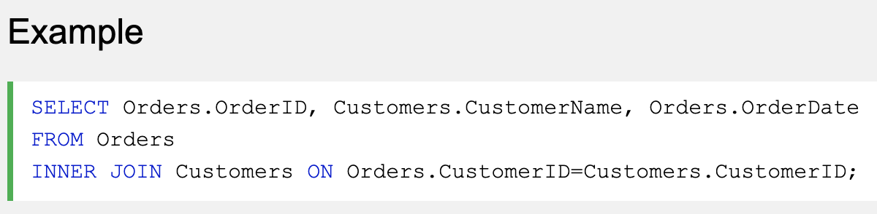
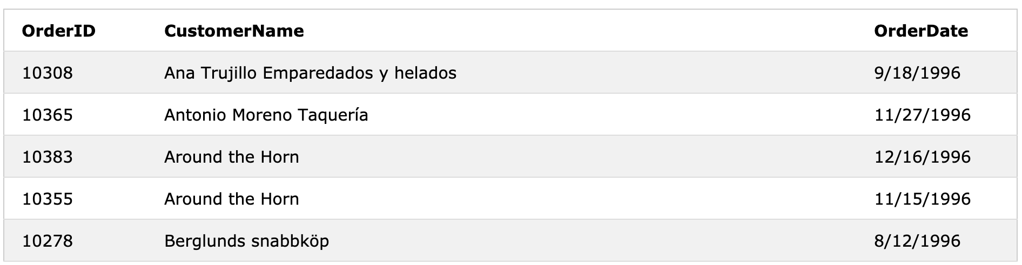
JOIN Syntax

Slide 53
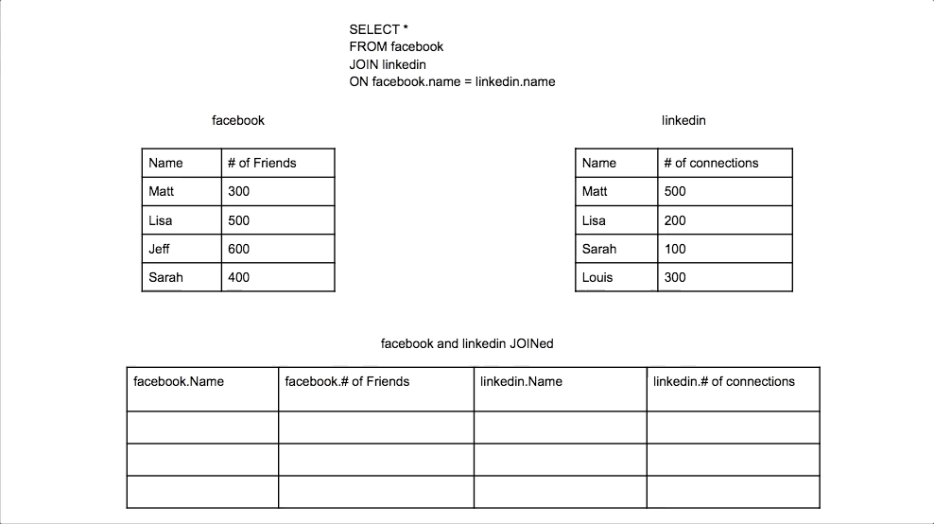
Another (animated) example

Slide 54
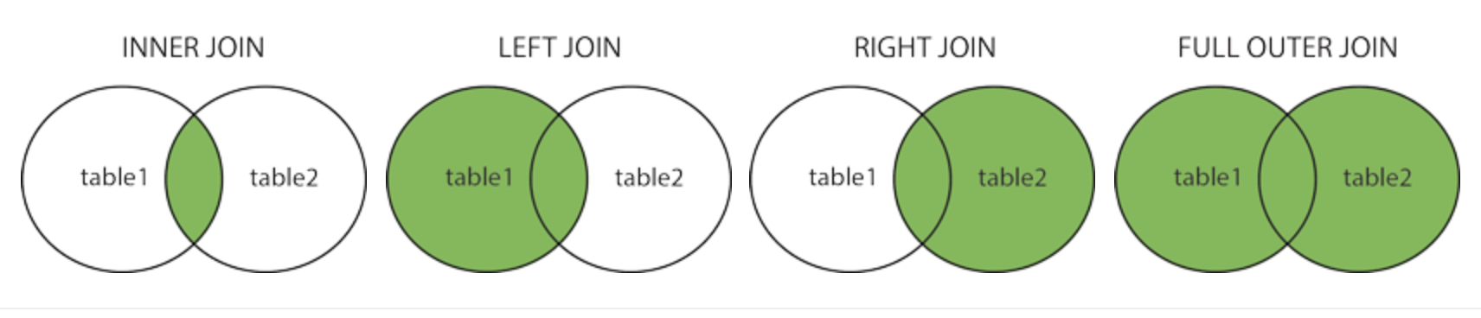
Different types of SQL joins
(INNER) JOIN: returns records that have matching values in both tables.
LEFT (OUTER) JOIN: returns all records from the left table, and the matched records from the right table.
RIGHT (OUTER) JOIN: returns all records from the right table, and the matched records from the left table.
FULL (OUTER) JOIN: returns all records when there is a match in either left or right table.

Slide 55
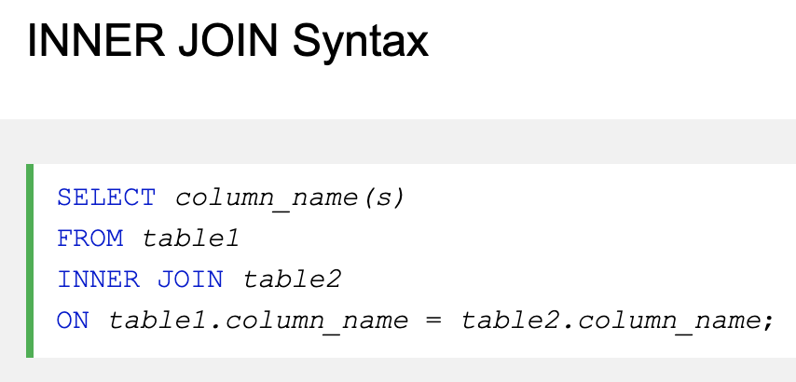
INNER JOIN syntax

Slide 56
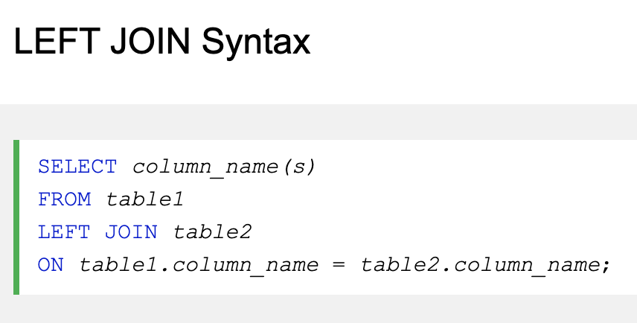
LEFT JOIN syntax

Slide 57
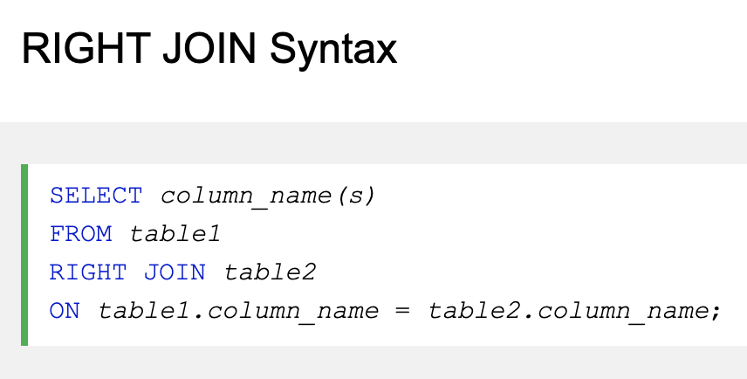
RIGHT JOIN syntax

Slide 58

FULL JOIN syntax

Slide 59

Self JOIN
Self JOIN: a self JOIN is a regular join, but the table is joined with itself.

Slide 60

Self JOIN example

Slide 61

UNION
UNION operator: used to combine the result-set of two or more SELECT statements.
Each SELECT statement within UNION must have the same number of cols.
The columns must have also similar data types.
The columns in each SELECT statement must also be in the same order.

Slide 62

Joins summary

Slide 63
Nested queries

Slide 64




Nested queries
A subquery in SQL is a query nested inside a larger query.
A subquery may occur in:
SELECT clause
FROM clause
WHERE clause
Without subquery
Students
Query to identify all students who get better marks than the student whose ID is ‘V002’
With subquery
Marks

Slide 65

Query Order of Execution

Slide 67
Practice Time!

Slide 68

Workbench Practice - HR database

Slide 69

Structure of HR DB

Slide 70
Questions part 1 - Warming up (Employees table)
Q1: Write a query to display the names (first_name, last_name) using alias name “First Name”, “Last Name”.
Q2: Write a query to get unique department ID from the employee table.
Q3: Write a query to get all employee details from the employee table. Order by first name, descending.
Q4: Write a query to get the total salaries, the maximum salary, the minimum salary and the average salary paid to the employees.
Q5: Write a query to get the number of employees working in the company.
Q6: Write a query to get the number of different jobs available in the employees table.
Q7: Write a query to select first 10 records.
Q8: Write a query to get the monthly salary (round 2 decimal) of each employee (assuming the salary is annual).

Slide 71
Questions part 2 - Heating up (Employees table)
Q9: Write a query to display the name (first and last) and salary of all the employees whose salary is not in the range 10,000 to 15,000.
Q10: Write a query to display the name (first and last) and hire date for all the employees who were hired in 1987.
Q11: Write a query to display the name of all employees who have both “b” and “c” in their first name.
Q12: Write a query to get the maximum salary of an employee working as a Programmer.
Q13: Write a query to get the number of employees with the same job. (hint: use GROUP BY).
Q14: Write a query to find for each manager ID the salary of the lowest-paid employee for that manager.
Q15: Write a query to find for each department id the total salary paid for that department.
Q16: Write a query to get the job ID and maximum salary of the employees where the maximum salary is greater than 4,000.

Slide 72
Questions part 3 - Holding on (Employees table and others)
Q17: Write a query to get the average salary for all departments employing more than 10 employees.
Q18: Write a query to find the name and the salary of the employees who have a higher salary than the employee whose last name is “Bull”.
Q19: Write a query to find the name of all employees who work in the IT dept.
Q20: Write a query to find the name of the employees who have a manager and the manager worked in a USA based department. (hint: use the departments and locations tables).
Q21: Write a query to find the name of the employees who are managers.
Q22: Write a query to find the name and salary of the employees whose salary is equal to the minimum salary for their job grade (hint: use the jobs table)
Q23: Write a query to find the addresses: location_id, street_address, city, state_province, country_name. (hint: join the locations and countries tables)
Q24: Write a query to find the name, department ID and name of all the employees (hint: use the departments table).

Slide 73
Questions part 4 - Spicing it up (Every table)
Q25: Write a query to find the name, job, department ID and name of the employees who work in London. (hint: use the departments and locations tables).
Q26: Write a query to find the employee id, name, along with their manager_id and last_name.
Q27: Write a query to find the name and hire date of the employees who were hired after ‘Jones’.
Q28: Write a query to get the department name and number of employees in the department.
Q29: Write a query to display the department ID and name and first name of the manager.
Q30: Write a query to display the department name, manager name and city.

Slide 74
Database design

Slide 75
ER (Entity-Relationships) diagrams (also ERD)
Database schema: structure of the Database in a described in a formal language
ER diagrams = graphical approach to database design
Entity: object we want to model & store information about
Attributes: specific pieces of information about an entity
Values: Each attribute can have values (one value or multiple values)
Primary Key: an attribute that uniquely identify an entry in the database table
Entities can have relationships with each other.
name
grade
student_id
gpa
Student

Slide 76
Relationships and participations
Relationships: defines a relationship between two entities (= two tables). It can be expressed as a verb. Example: an student takes a class
Relationship cardinality: number of instances of an entity from a relationship that can be associated with the relation
Total participation: All members must participate in the relationship (double line)
Partial participation: single line
grade
name
gpa
student_id
student_id
Takes
Student
Class
Partial participation
Total participation

Slide 77

3 types of relationships in Database design (1/3)
One-to-One: a row in table A can have only one matching row in table B (and vice-versa).
This is not a common relationship (since the data could have been stored in the same unique table).
Valid reasons to do so: divide a larger table, security purposes, …
Noted in diagrams: 1:1

Slide 78

3 types of relationships in Database design (2/3)
One-to-Many (or Many-to-One): Most common relationship type. A row in table A can have many matching rows in table B. But a row in table B can have only one matching row in table A.
One-to-Many relationships can also be viewed as Many-to-One relationships.
In the example, the Customer table is the “many” and the City table is the “one”.
Each customer can only assigned to one city.
One city can be assigned to many customers
Noted in diagrams: 1:N

Slide 79

3 types of relationships in Database design (3/3)
Many-to-Many: A row in table A can have many matching rows in table B and vice versa.
Can also be interpreted as two one-to-many relationships linked by an intermediary table.
The intermediary table is referred as a junction table (=cross-reference table).
This table is used to link the two tables together.
It has two fields that reference the PK of each of the two tables.
Noted in diagrams: M:N
The Orders table is a junction table that cross-references the Customers table with the Products table.

Slide 80
From ER Diagrams to schemas (Advanced)
Step 1 - Mapping of regular entity types: for each regular entity, create a table that includes all the attributes of that entity.
Step 2 - Mapping of weak entity types: for each weak entity, create a table that includes all simple attributes of that entity.
Step 3 - Mapping of binary 1:1 relationship types: include on side of the relationship as a foreign key in the other favor total participation (if possible).
Step 4 - Mapping of binary 1:N relationship types: include the 1 side’s PK as a FK on the N side relation.
Step 5 - Mapping of binary M:N relationship types: create a new table whose PK is a combination of both entities’ PKs. Also include any relationship attributes.

Slide 81
Exercise: Company Data Storage Requirements
The company is organized into branches. Each branch has a unique number, a name, and a particular employee who manages it.
The company makes its money by selling to clients. Each client has a name and a unique number to identify it.
The foundation of the company is it’s employees. Each employee has a name, birthday, sex, salary and a unique number.
An employee can work for one branch at a time, and each branch will be managed by one of the employees that work there. We’ll also want to keep track of when the current manager started as manager.
An employee can act as a supervisor for other employees at the branch, an employee may also act as the supervisor for employees at other branches. An employee can have at most one supervisor.
A branch may handle a number of clients, with each client having a name and a unique number to identify it. A single client may only be handled by one branch at a time.
Employees can work with clients controlled by their branch to sell them stuff. If necessary multiple employees can work with the same client. We’ll want to keep track of how many dollars worth of stuff each employee sells to each client they work with.
Many branches will need to work with suppliers to buy inventory. For each supplier we’ll keep track of their name and the type of product they’re selling the branch. A single supplier may supply products to multiple branches.
Given the description above, draw the ER Diagram of the company.

Slide 82

Solution

Slide 83

Installation

